Slide 1
Business Intelligence G. Mudare
Notes:
Introduce yourself to the students and also find out there names
Have them give you in 30 seconds a summary of who they are and what there interest in IT is

Slide 2
Data Transformation
Handling Missing Values

Slide 3
Data Transformation Missing Values
How can you go about filling in the missing values for attributes?
Ignore the tuple:
done when the class label is missing,
not very effective, unless the tuple contains several attributes with missing values,
poor when the percentage of missing values per attribute varies considerably.
Fill in the missing value manually
approach is time-consuming and may not be feasible given a large data set with many missing values.
Use a global constant to fill in the missing values
Replace all missing attribute values by the same constant, such as a label like “Unknown” or NA
If missing values are replaced by, say, “Unknown,” then the program may mistakenly think that they form an interesting concept, since they all have a value in common—that of “Unknown.”
although this method is simple, it is not fool proof

Slide 4
Missing Values
Use the attribute mean to fill in the missing value:
For example, suppose that the average income of customers is $56,000. Use this value to replace the missing value for income.
Use the attribute mean for all samples belonging to the same class as the given tuple
If classifying customers according to credit risk, replace the missing value with the average income value for customers in the same credit risk category as that of the given tuple.
Use the most probable value to fill in the missing value:
may be determined with regression, inference-based tools using a Bayesian formalism, or decision tree induction
Eg using the other customer attributes in your data set, you may construct a decision tree to predict the missing values for income.

Slide 5
Data Transformation Missing Values
It is important to note that, in some cases, a missing value may not imply an error in the data!
Although we can try our best to clean the data after it is seized, good design of databases and of data entry procedures should help minimize the number of missing values or errors in the first place

Slide 6
Noisy Data
Noise:
random error or variance in a measured variable (numeric attribute value)
Incorrect attribute values may be due to
faulty data collection instruments,
data entry problems,
data transmission problems,
technology limitation,
inconsistency in naming convention

Slide 7
How to Handle Noisy Data
Given a numerical attribute such as, say, price, how can we “smooth” out the data to remove the noise

Slide 8
How to Handle Noisy Data
Binning method:
–first sort data (values of the attribute we consider) and partition them into (equal-depth) bins
–then apply one of the methods:
smooth by bin means,(replace noisy values in the bin by the bin mean)
smooth by bin median,(replace noisy values in the bin by the bin median)
smooth by bin boundaries,(replace noisy values in the bin by the bin boundaries)
Clustering
–detect and remove outliers
Combined computer and human inspection
detect suspicious values and check by human
Regression
smooth by fitting the data into regression functions

Slide 9
Simple Discretization Methods: Binning
Equal-width(distance) partitioning:
–It divides the range (values of a given attribute) into Ni ntervals of equal size: uniform grid
–if A and B are the lowest and highest values of the attribute, the width of intervals will be: W = (B-A)/N.
The most straight forward
–But outliers may dominate presentation
–Skewed data is not handled well.

Slide 10
Simple Discretization Methods: Binning
Equal-depth(frequency) partitioning:
–It divides the range (values of a given attribute)
–into N intervals, each containing approximately same number of samples (elements)
–Good data scaling
–Managing categorical attributes can be tricky.

Slide 11
Binning Methods for Data Smoothing (book example)
Sorted data (attribute values ) for price (attribute: price in dollars):
4, 8, 9, 15, 21, 21, 24, 25, 26, 28, 29, 34
Partition into (equal-depth) bins:
Bin 1: 4, 8, 9, 15
Bin 2: 21, 21, 24, 25
Bin 3: 26, 28, 29, 34
•Smoothing by bin means:
Bin 1: 9, 9, 9, 9
Bin 2: 23, 23, 23, 23
Bin 3: 29, 29, 29, 29
9, 9, 9, 9, 23, 23, 23, 23, 29, 29, 29, 29
•Smoothing by bin boundaries:
Bin 1: 4, 4, 4, 15
Bin 2: 21, 21, 25, 25
Bin 3: 26, 26, 26, 34
4, 4, 4, 15, 21, 21, 25, 25, 26, 26, 26, 34
Replace all values in a BIN by ONE value (smoothing values)

Slide 12
(book example)
Sorted data for price (in dollars): 4, 8, 15, 21, 21, 24, 25, 28, 34
Partition into (equal-frequency) bins:
Bin 1: 4, 8, 15
Bin 2: 21, 21, 24
Bin 3: 25, 28, 34
Smoothing by bin means:
Bin 1: 9, 9, 9
Bin 2: 22, 22, 22
Bin 3: 29, 29, 29
Smoothing by bin boundaries:
Bin 1: 4, 4, 15
Bin 2: 21, 21, 24
Bin 3: 25, 25, 34

Slide 13
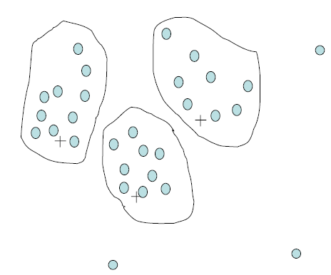
Cluster Analysis
Analysis Perform clustering on attributes values and replace all values in the cluster by a cluster representative

Slide 14
Clustering
Partition data set (or values of an attribute) into clusters, and one can store cluster representation only
Can be very effective if data is clustered but not if data is “smeared”
Can have hierarchical clustering and be stored in multi-dimensional index tree structures
There are many choices of clustering definitions and clustering algorithms

Slide 15
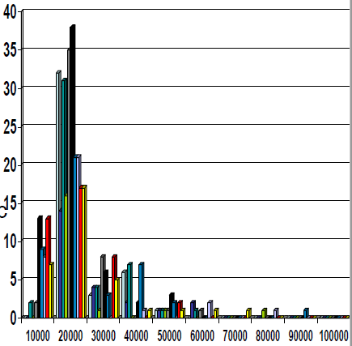
Histograms
A popular data reduction
Technique
•Divide data into buckets and store average (sum) for each bucket
•Can be constructed optimally in one dimension using dynamic programming
•Related to quantization problems.

Slide 16
Sampling
Sampling allows a mining algorithm to run in complexity that is potentially sub-linear to the size of the data
Sampling is a method of choosing a representative subset of the data
Random sampling may have very poor performance in the presence of skew data
There are adaptive sampling methods
Stratified sampling:
•Approximate the percentage of each class (or subpopulation of interest) in the overall database
•Used in conjunction with skewed data

Slide 17
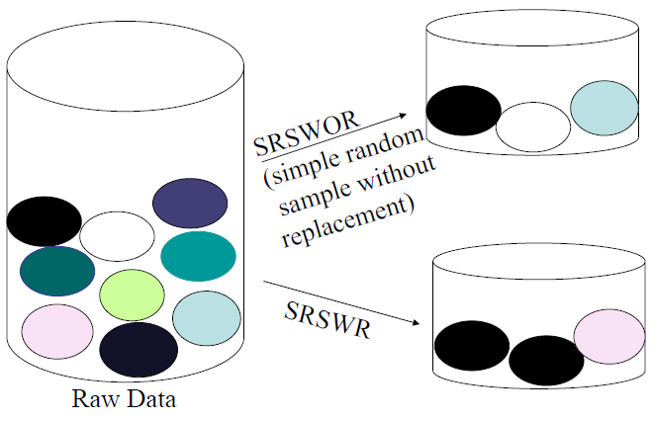
Sampling

Slide 18
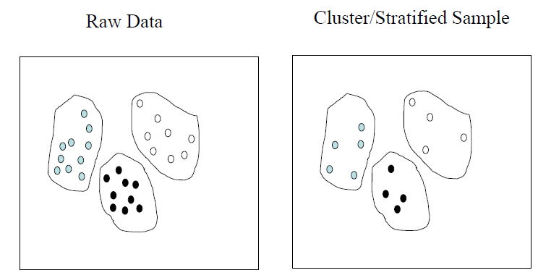
Sampling

Slide 19
Discretization
Three types of attributes:
Nominal —values from an unordered set
Ordinal —values from an ordered set
Continuous —real numbers
Discretization:
divide the range of a continuous attribute into intervals
–Some classification algorithms only accept categorical (non-numerical) attributes.
–Reduce data (attributes values) size by discretization
–Prepare for further analysis

Slide 20
Concept hierarchy
Concept hierarchies
Reduce the data by collecting and replacing low level concepts (such as numeric values for the attribute age) by higher level concepts (such as young, middle-aged, or senior).

Slide 21
Discretization and concept hierarchy Generation for numeric data
Discretization:
Binning (Discussed before)
•Histogram analysis (Discussed before)
•Clustering analysis (Discussed before)
•Entropy-based discretization
•Segmentation by natural partitioning

Slide 22
Segmentation by natural partitioning
3-4-5 rule can be used to segment numeric data (attribute values) into relatively uniform, “natural”intervals.
If an interval covers 3, 6, 7 or 9 distinct values at the most significant digit, partition the range into 3 equi-width intervals
If it covers 2, 4, or 8 distinct values at the most significant digit, partition the range into 4 intervals
If it covers 1, 5, or 10 distinct values at the most significant digit, partition the range into 5 intervals

Slide 23
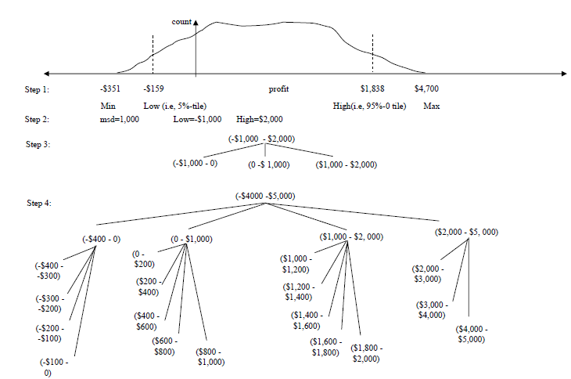
Segmentation by natural partitioning

Slide 24
Concept hierarchy generation for categorical data
Concept hierarchy is:
Specification of a partial ordering of attributes explicitly at the schema level by users or experts
Specification of a portion of a hierarchy by explicit data grouping
Specification of a set of attributes, but not of their partial ordering
Specification of only a partial set of attributes

Slide 25
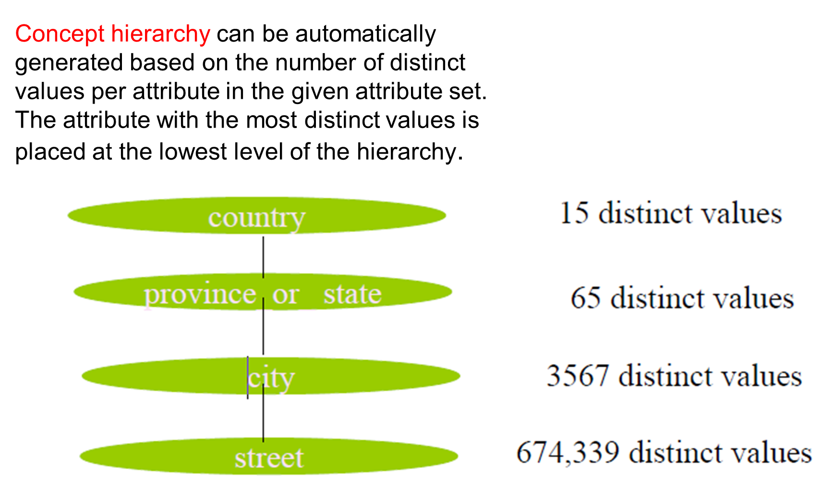
Specification of a set of attributes

Slide 26
Summary
Data preparation and pre-processing is a big issue for Business intelligence
•Data pre-processing includes
–Data cleaning and data integration
–Data reduction and attributes selection
–Discretization
A lot of methods have been developed but still an active area of research

